Slide 1
Environmental management in today's realities
25th anniversary of the Karachaganak Project’s FPSA

Slide 2


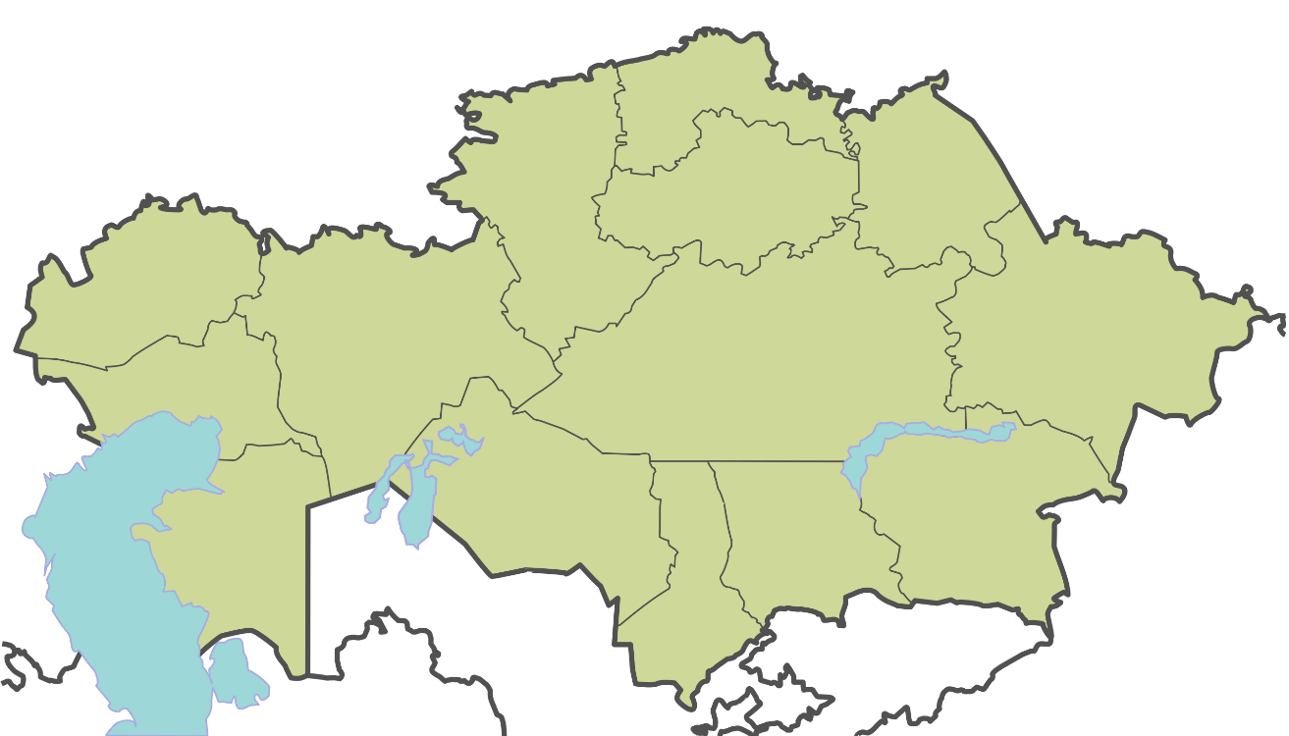
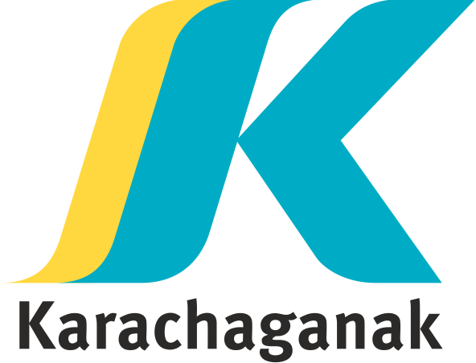
History of KPO
1979 y.
the Karachaganak oil and gas condensate field is discovered
1997 y.
the Main Production Sharing Agreement (FPSA) is signed
1998 -2022 y.
Some 97 billion tenge was invested in
environmental protection measures
Notes:
Компания Карачаганак Петролиум Оперейтинг является оператором Карачаганакского нефтегазоконденсатного месторождения, расположенного в ЗКО – одного из крупнейших нефтегазоконденсатных месторождений в мире.
За 25 лет, в течение которых КПО является оператором Карачаганакского месторождения, в природоохранные мероприятия инвестировано порядка 97 млрд. тенге, что составляет около 0.5 млрд. долларов.

Slide 3





Environmental performance
Gas utilisation is 99,94%
а 37% reduction in total air emissions compared to 2020 to 4,8 thousand tonnes in 2021
around of 90% own industrial waste is recycled at the Eco-Centre
Green Transformation Programme implemented to achieve carbon neutrality and climate change solutions.
A biodiversity action plan is being implemented
Notes:
Реализуемые мероприятия по ООС помогают КПО достигать поставленных природоохранных целей и воплощать «зеленые» инициативы. Так, наример:
По результатам за 2021 г утилизация газа достигла 99,94%, несмотря на увеличение объемов добычи УВС. Это позволяет говорить о КПО, как о Компании имеющей один из самых высоких уровней утилизации газа не только в Казахстане, но и в мире, успешно выполняющей все необходимые мероприятия по сокращению и поддержанию стабильно низких объемов сжигания газа в рамках технологически неизбежных для обеспечения безопасности производственных процессов.
В 2021 году общий объем выбросов в атмосферу на 37% уменьшился по сравнению с 2020 г. и составил 4,8 тыс. тонн при добыче более 134 млн. БНЭ (BOE)
Около 90% собственных отходов производства и потребления перерабатывается и утилизируется на Эко-Центре – современном комплексе, который соответствует мировым стандартам по повторной переработке и безопасному для окружающей среды захоронению буровых отходов.
Внедрена Программа «зеленой трансформации» для достижения углеродной нейтральности и решений проблемы климатических изменений.
С 2011 года КПО проводит поэтапную оценку состояния биоразнообразия и оценивает воздействие производственной деятельности на животный и растительный мир Карачаганакского месторождения и сопредельных территорий.

Slide 4
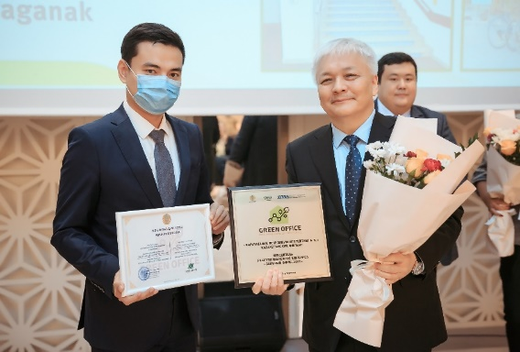


KPO environmental initiatives
Pilot project Green Office:
III National Green Office 2021 Contest
Business Centre Karachaganak, Aksai
Kurmangazy office, Uralsk;
KPO is the winner in the category for industrial enterprises
A number of environmental seminars and training sessions have been held
Introduced separate waste collection
A team of eco-volunteers has been formed
Paryz Republican Contest 2021
>200 employees trained
In 2022 - in 2 offices Aliya and Samal 2
Notes:
In October 2021, KPO became one of the winners of the III Republican contest "Green Office - 2021". The purpose of the competition is to promote an ecological lifestyle, "green" and low-carbontechnologies, improving environmental friendliness, disseminating best practices and technological solutions of best practices, as well as promoting the creation of comfortable working conditions for the formation of a friendly attitudeniya to the environment.More than 100 organizations from the field of education, healthcare, public authorities, international organizations and representative offices, industrial enterprises, business and shopping centers, financial organizations and NGOs took part in the Green Office 2021 competition. As a result of the competition, 30 enterprises became winners in various nominations. KPO was named the winner in the nomination for industrial enterprises.
In December 2021, the results of the republican competition on social responsibility of business "Paryz" 2021 were summed up. The "Paryz" award is one of the most prestigious awards of the Republic. It is awarded to companies for their contribution to improving the well-being of citizens, active support of social initiatives, care for the environment and creating the best working conditions for their employees. At the same time, the highest award of the competition is awarded to the applicant who has achieved the highest results in the field of corporate social and environmental responsibility.
KPO received the Grand Prix of the "Paryz" competition in the following three nominations at once: "Best socially responsible enterprise", "Best enterprise in the field of labor protection" and "For contribution to the environment".

Slide 5
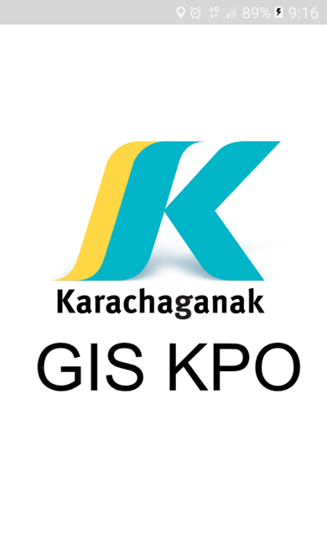
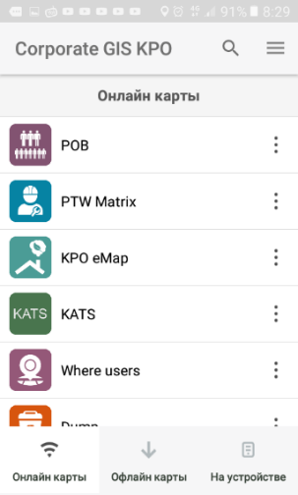
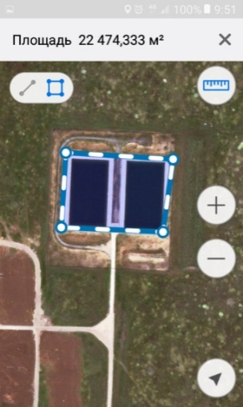
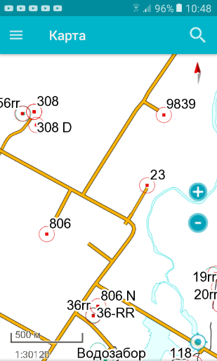
KPO GIS mobile application
Description:
The app is designed for iOS and Android platforms to work in the field, both online and when there is no internet access (offline).
The application is used:
-- when collecting environmental and other information during field surveys, inspections and audits in online and offline modes;
to search for infrastructure facilities (wells, production facilities, monitoring points);
to navigate the territory of the Karachaganak Field.
The use of the KPO GIS mobile app allows
-Significantly reduce costs when working with data - the data goes directly from the mobile app to the CoGIS database of the corporate geographical information system;
- eliminate the human factor from the work process when entering data into the database;
- significantly reduce the risk of errors / typos in the data as compared to 'manual' data entry from different sources.
Notes:
With the development of the field and production capacities, as well as with the tightening of the requirements of environmental legislation, the flow and volume of environmental information is constantly growing, therefore, there is an urgent need to introduce digital technologies / tools to effectively manage huge data flows.
I would like to take a closer look at some of the most striking examples of the implementation of digitalization projects in KPO.
KPO has been implementing, developing and actively using ArcGIS technologies since 2005. For more than 16 years of using ArcGIS KPO, an extensive database has been accumulated and many tools have been developed for working with data..
To popularize GIS technologies in KPO and provide a wide range of users with a simple, easy-to-use and effective tool for accessing and working with geodata, in 2017, the CoGIS web portal and the KPO GIS mobile application based on the ArcGIS core (ESRI) and technologies from DataEast were developed and implemented.
This software package allowed us to take the work with data (collection, storage and processing / analysis) to a new level - users were able to use GIS technologies without the special knowledge and skills that were previously required to work with ArcGIS (ESRI) software.
In the process of developing corporate GIS KPO, it became necessary to use the GIS KPO mobile application in the absence of an Internet connection to the database (work in the field outside the coverage area of mobile GSM networks).
Together with the developers of CoGIS, we implemented a number of activities that allowed us to introduce innovative solutions and get an updated application with the necessary functionality. The GIS KPO mobile application has a section "Offline maps". Now, when leaving the field, the user can be sure that the planned scope of work will be completed in the proper quality and without wasting time working with a paper map, and upon returning to the office, the collected data will be automatically synchronized with the KPO GIS database.
From October 22 to 25, 2019, Moscow hosted the 25th anniversary conference of ESRI in Russia and the CIS, in which KPO took part as a speaker and presented an application for working with offline maps and was called "Automation of building offline maps and collecting data in the absence of Internet using a mobile application. Despite the large number of speakers, it was the KPO report that aroused the greatest interest and wide resonance among GIS users. KPO's speech was attended, among others, by leading developers and executives of DATA+ LLC (an international distributor of geoinformation systems of the ESRI family), the organizer of the annual ESRI conference in Russia and the CIS.
After the report, many questions were asked both in the audience and on the sidelines, which we answered with pleasure.

Slide 6
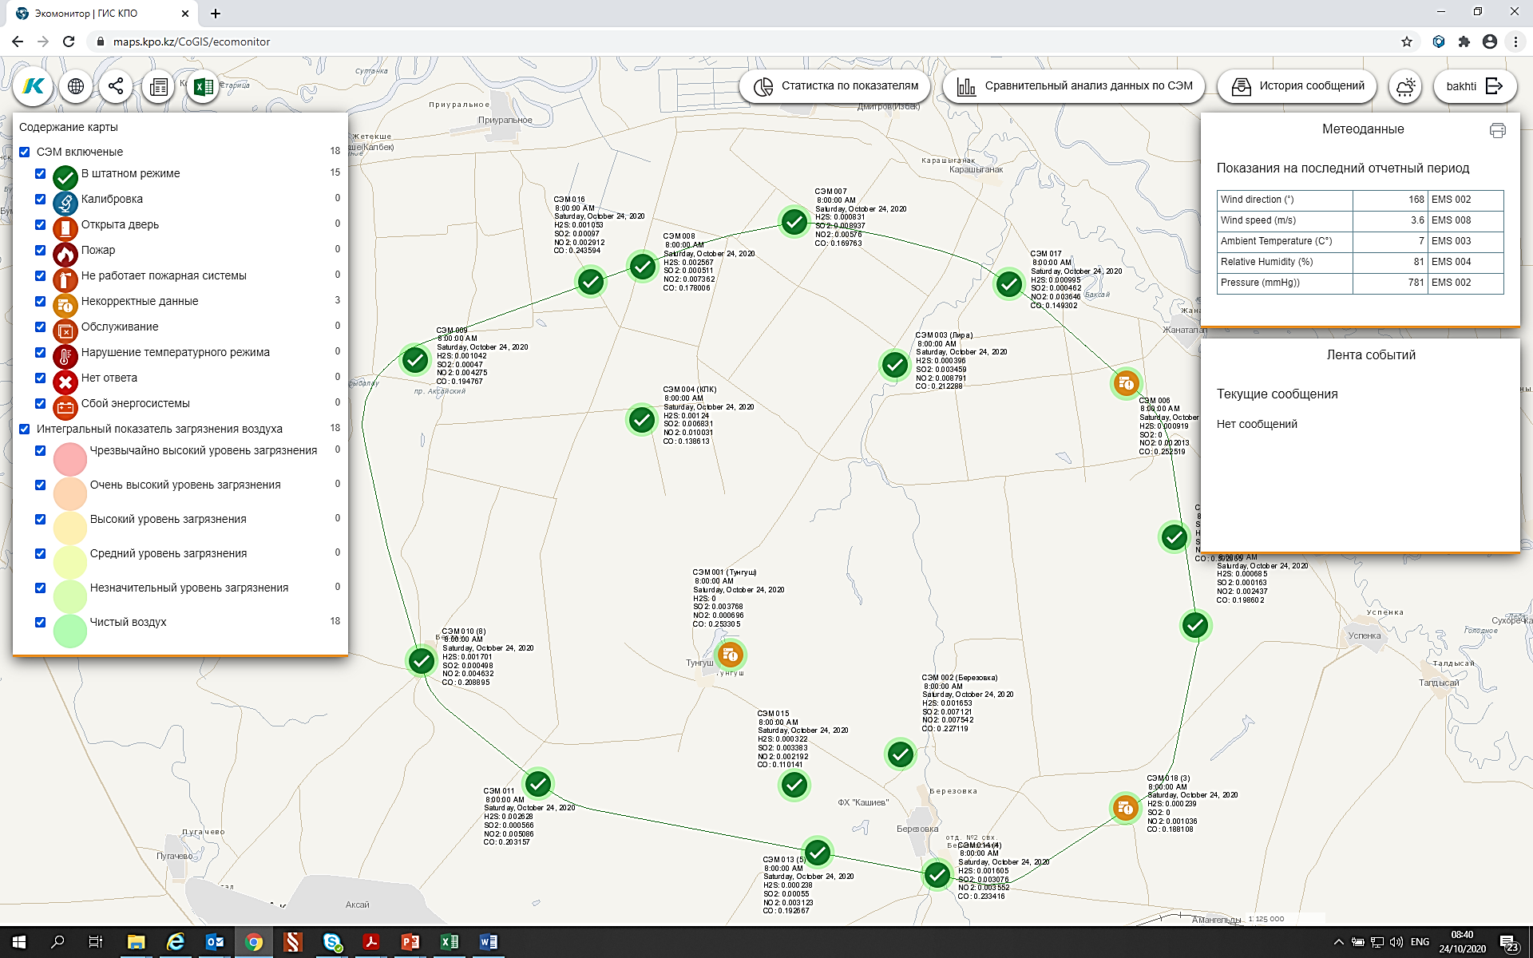
Automatic air monitoring system
Implementation phase | Period | Cost, million tenge
EMS 001 - 004 (KOGCF) | 2000 - 2004 | 117,8
EMS 005 – 012 (SPZ KOGCF) | 2005 - 2006 | 707,8
EMS 013 – 014 (Berezovka) EMS 015 – 018 (corrected KOGCF SPZ) | 2011 - 2013 | 2 071
Online data transmission system KPO EMS in WKO RSE Kazhydromet | 2013 | 4
KPO EMS Online Data Transfer System to the WKO Department of Ecology | 2018 | No cost
EMS movement 006, 009, 011, 012, 016 и 018 | 2019 - 2020 | 3 841
EMS movement 005 и 015 | 2021 | 1272
Project implementation period - 2000-2021
Total cost - 12 billion tenge
Notes:
On the basis of the KPO corporate GIS, a subsystem was created for online transmission of KPO EMS data to the territorial subdivision of the authorized body in the field of environmental protection (DE for WKO)

Slide 7
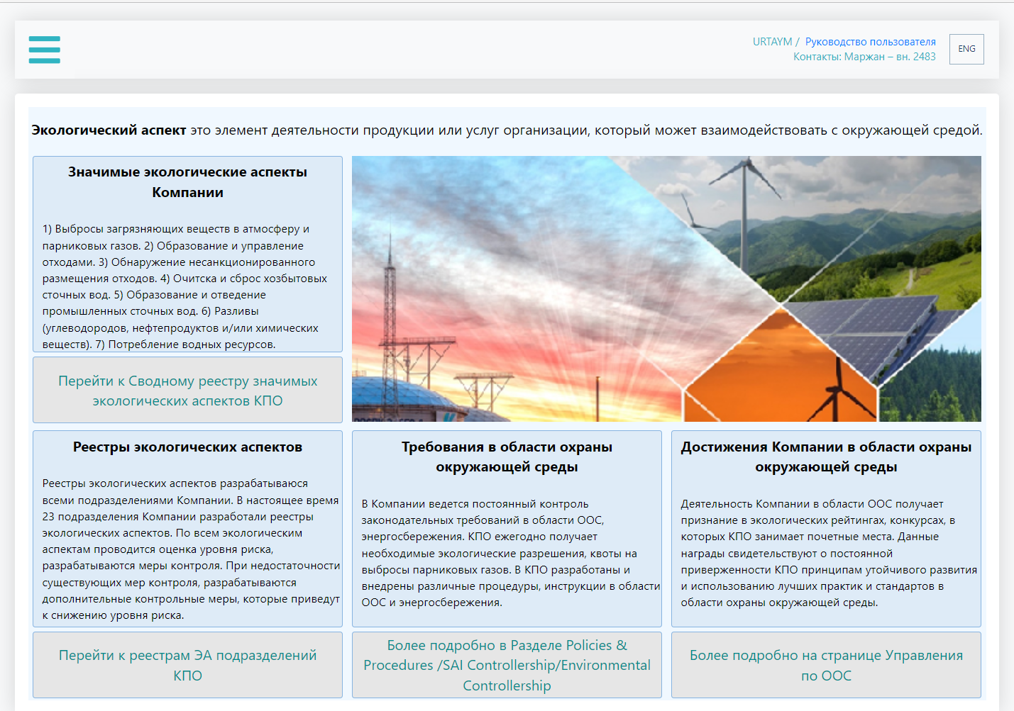
KPO Electronic System of Registers of Environmental Aspects
The electronic system http://envar/ allows you to manage registers of environmental aspects of KPO divisions and, on their basis, identify the most significant environmental aspects
Identification of all EA of the Company
23 KPO divisions identify environmental aspects from their activities.
Identification of EAs that have a significant impact
Significant environmental aspects are identified in the register of each unit.
Determination of the most significant EA
Consolidated register of the most significant environmental aspects of the entire Company.
Notes:
Электронная система http://envar/ позволяет управлять реестрами экологических аспектов 23 подразделений КПО и на их основе в автоматическом режиме выявлять наиболее значимые экологические аспекты.
Реестр каждого подразделения утверждается менеджером и каждый сотрудник КПО имеет доступ ко всем реестрам в электронной системе.
КПО ежегодно пересматривает реестры экологических аспектов и в отношении значимых аспектов определяются дополнительные меры контроля.
Значимые экологические аспекты КПО
Выбросы загрязняющих веществ и парниковых газов;
Образование и управление отходами;
Образование и отведение сточных вод;
Потребление природных ресурсов;
Возможные разливы углеводородов.

Slide 8
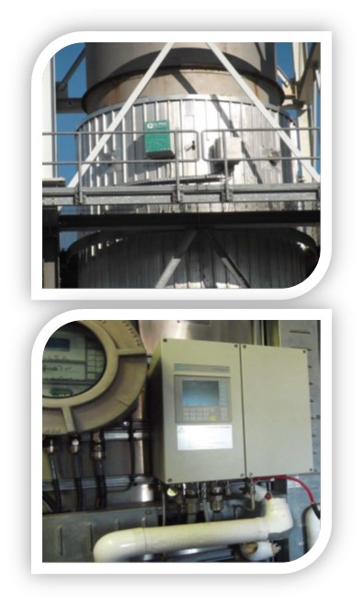
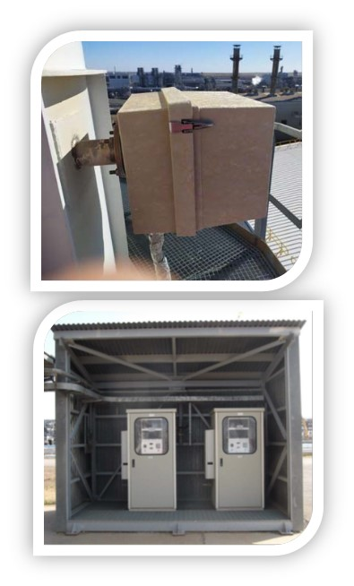
Automatic emission monitoring system
Implementation stage | period | Cost, mln. tenge
feasibility | 2018 | 189
Working project | 2020 | 185
Detailed design and procurement of equipment | 2021 | 943
Supply of equipment, construction and commissioning | 2022 | 1472
Project implementation period – 2018-2022 y.
Total estimated cost – 2,7 billion tenge
Notes:
В процессе реализации

Slide 9

THANK YOU FOR YOUR ATTENTION!
Обсуждение Дорожной карты по комплексному решению экологических проблем Западно-Казахстанской области 08/04/2022 © 2022 Карачаганак Петролиум Оперейтинг б.в.

