Slide 1


5 current challenges in waste management in Kazakhstan
yuliya dushkina
Kazakhstan Waste Management Association "KazWaste"
10 june 2022, V Uralsk Green Forum

Slide 2

Kazakhstan waste management association “KazWaste”
9 years in waste management section
50 enterprises for collection, treatment, disposal of various types of waste from all regions of Kazakhstan
5 accreditations in state authorities and Atameken NCE
Status of self-regulating organisation (2017)
A founder of the first waste exchanges in Kazakhstan https://waste-ex.kz/ (2019)
A facilitator of the largest annual «Green Energy & Waste Recycling» Forum https://gewr.kz/ (2015)

Slide 3
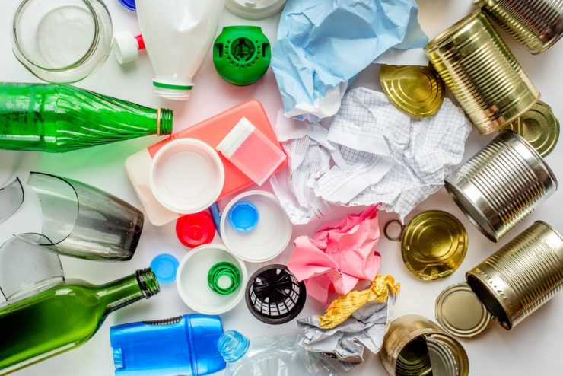
Waste prevention
1

Slide 4

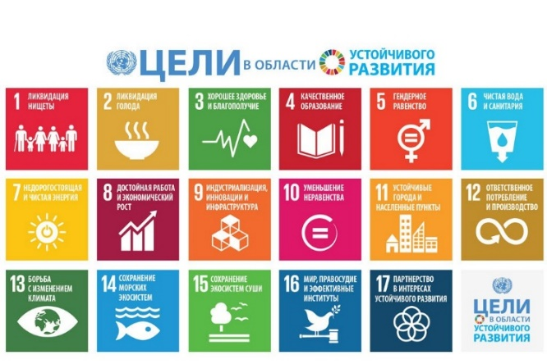
Waste prevention in SDG
Goal 12.3 By 2030, reduce by half… food waste … and reduce food losses …
Indicator 12.3.1 а) food loss index and (b) food waste index
Goal 12.4 By 2020, achieve the environmentally sound management of chemicals and all waste throughout their life cycle in ….
Indicator 12.4.2 a) Hazardous waste generation per capita and b) percentage of treated hazardous waste detailed per treatment types
12 Responsible consumption
and production

Slide 5
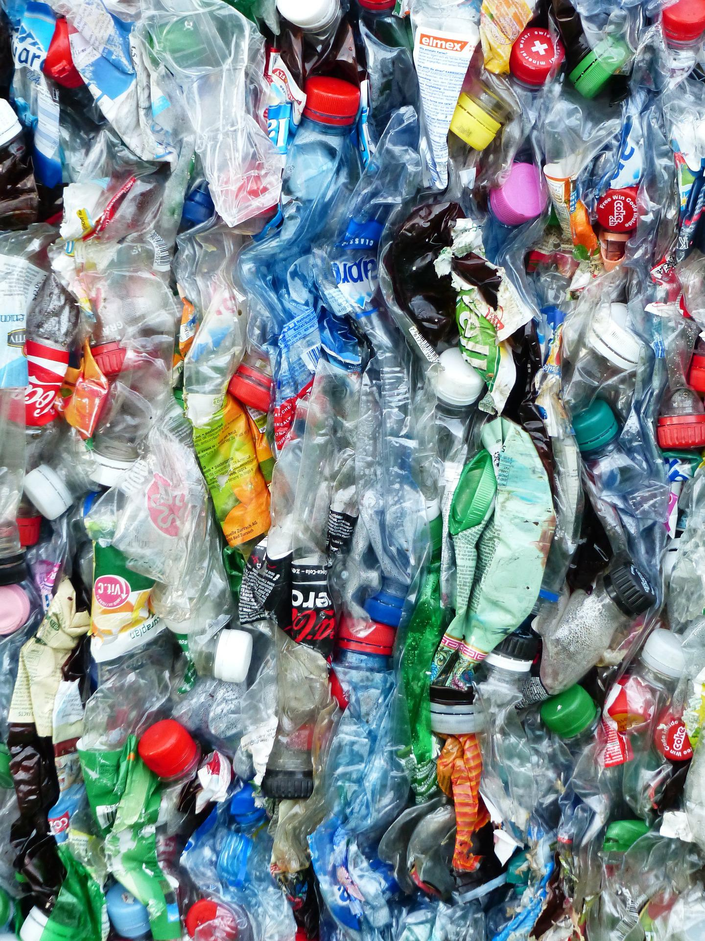
Prevention of plastics generation
A meeting of Open-ended Working Group was held to prepare for the intergovernmental negotiating to end plastic pollution on 30 May – 1 June 2022 in Dakar, Senegal
Challenging themes:
Plastic causes pollution throughout the life cycle, from extraction of raw materials to production, use and recycling of waste.
The problem is that we produce too much plastic, thereby contributing to waste generation.
Cutting the plastics industry is the problem solution.
Global agreement on plastics to be fully negotiated by the end of 2024.

Slide 6
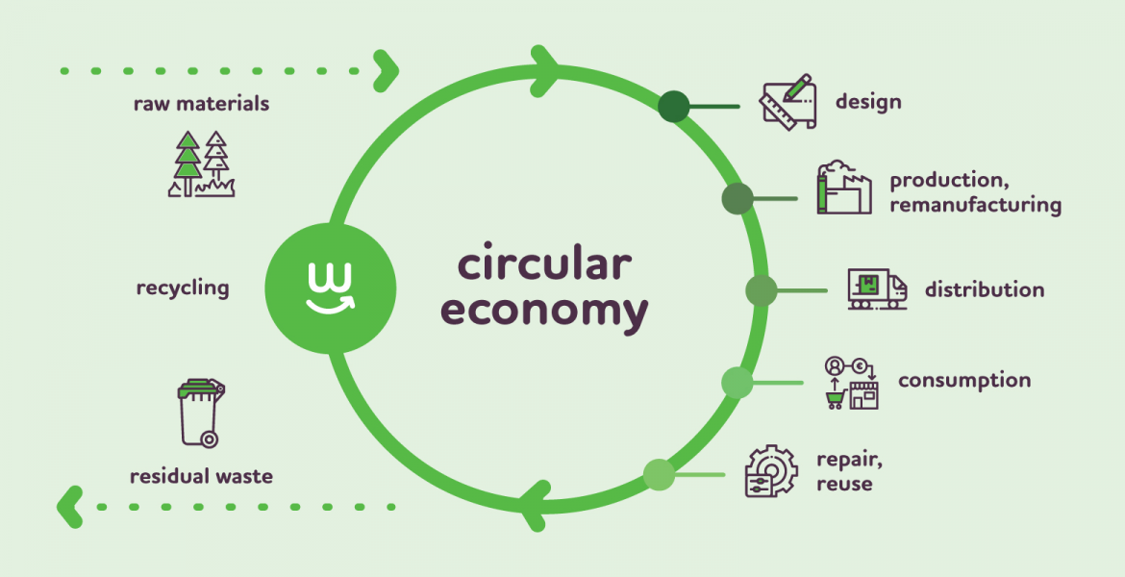
Circular economy development
2

Slide 7
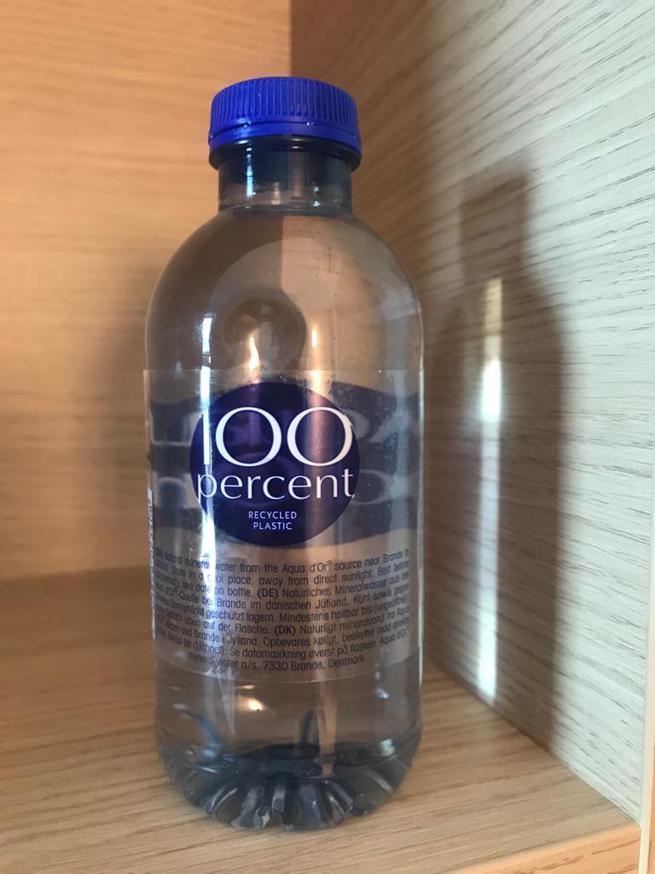
EU action plan to develop circular economy
Sustainable products designing (promoting products longevity, information digitalization, etc.)
Standartization and packaging reuse
100% use of secondary raw materials in the production of products (polyethene, polyester, paper, etc.)
Circularity in production processes

Slide 8
A percentage of waste treatment and recycling in Kazakhstan
Source: https://stat.gov.kz/

Slide 9
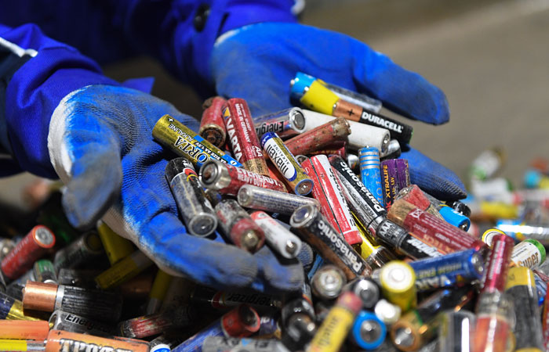
Reduction of chemical waste pollution
3

Slide 10
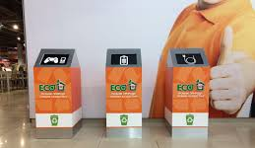
Strengthening control over e-waste handling
Health Impact
Cancerigenic (cancer causing)
Endocrine disorders
Fetal growth and fetation (low birth weight, small head circumference, intrauterine growth restriction)
Neuro development and cognitive function (intelligence quotient deficiency)
Impact on the behaviour (decreased alertness, reduces ability to cope with disappointment, hyperactivity, bad social behavior, mental depression)
Reproductive effect
Metabolic diseases
Bone injury
Liver damage
Lung injury
Kidney damage
Cardiovascular system
Suppression of the immune system
Immune system stimulation, that promotes development of allergy and autoimmunity
Volume of e-waste generation in Kazakhstan – 7,3 kg/person
E-waste collection rate – 8,8%

Slide 11
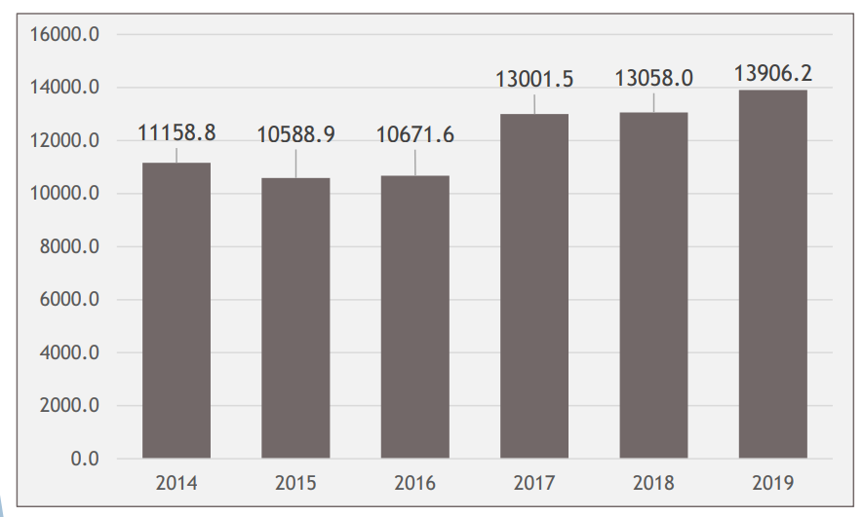
Pesticide management tightening
1 154 pesticides are registered in Kazakhstan
35% of them contain active substances from the PAN list (Pesticide Action Network)
25 active substances, which are banned in the other countries, are used in Kazakhstan
Outdated and unusable agricultural pesticides are a source of chemical pollution
Total amount of pesticides introduced in Kazakhstan, tonnes

Slide 12
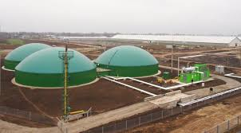
Reducing carbon foot printing in waste sector
4

Slide 13
Waste management sector and greenhouse gases
Current situation:
6% of total volume of GHG emissions:
2/3 of SDW
1/3 of wastewater
2% of hospital waste
Key decarbonization efforts in draft strategy for achieving carbon neutrality:
the accelerated implementation of complete coverage of SDW collecting and sorting with the further achievement of blanket population coverage by separate collection system;
reduction of waste and wastewater generation volumes and improving wastewater treatment technologies, including biogas producing;
increasing in the proportion of recycled and composted waste to ensure environmentally sound waste management and implement circular economy.
 | Total (combined) reduction of emissions over a period
Sector | 2030 (by 2020) | 2040 (by 2030) | 2050 (by 2040) | 2060 (by 2050)
Waste | 1,3% | 2,5% | 1,4% | 1,2%
*A Draft Strategy for Achieving carbon neutrality

Slide 14

Collaboration and universal responsibility
5

Slide 15
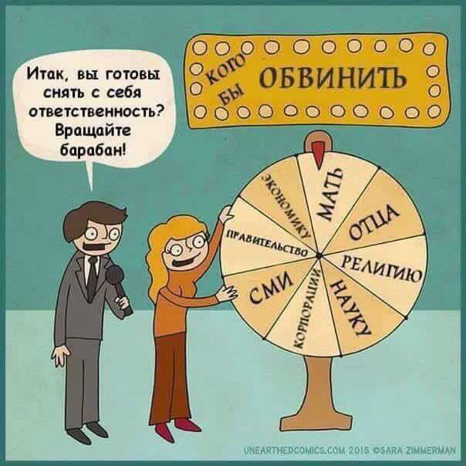
Responsibility for clean office, house, city, country lies with each of us!
Well, are you ready to take away responsibility from yourself? Spin the reels!
Someone to blame
Combined efforts must be made by all concerned:
A state
Products producers
Industrial companies
Waste management facilities
NGO, public, residents

Slide 16
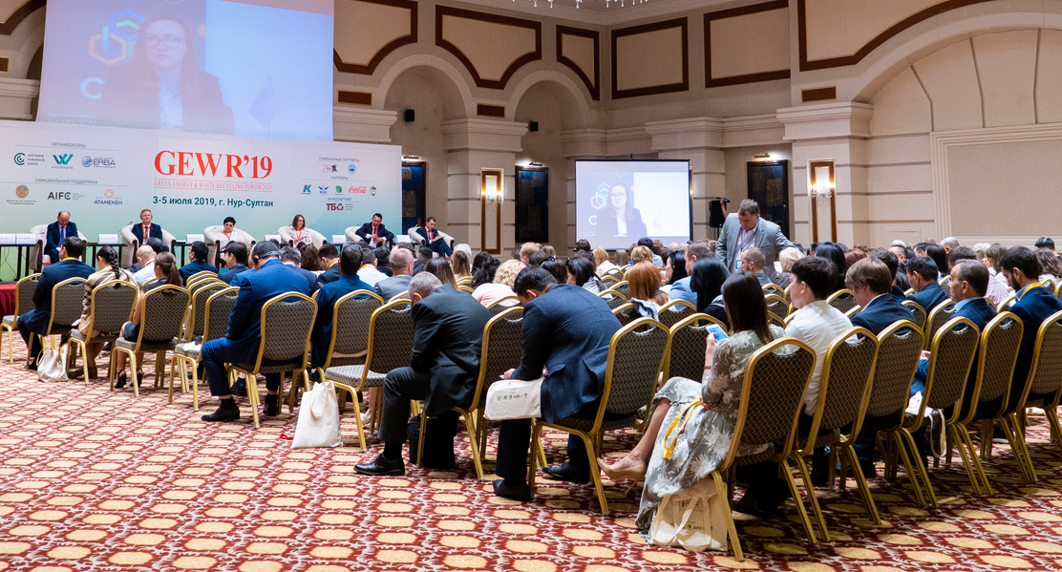
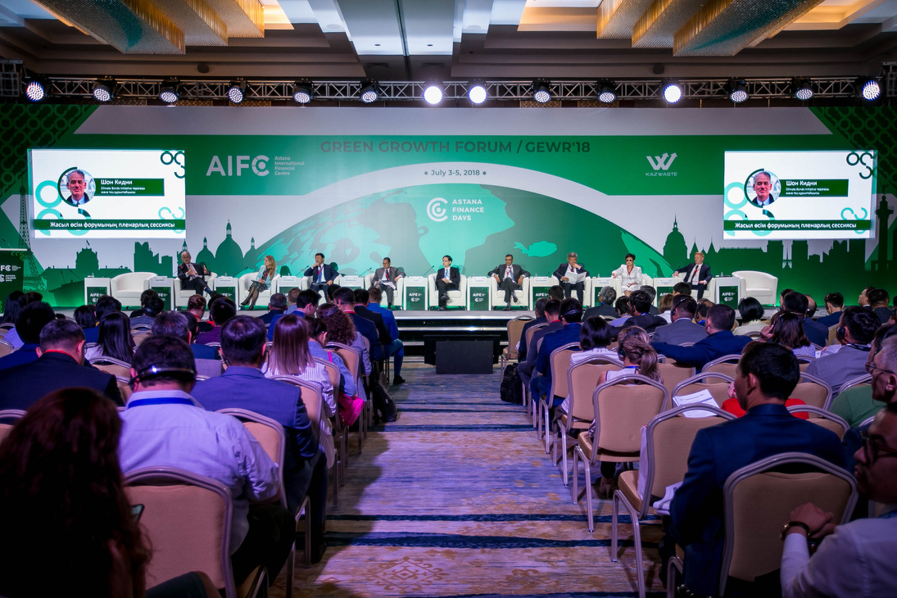



VI EURASIAN business forum
“Green Energy & Waste Recycling Forum’22”
4-5 JULY 2022,
NUR-SULTAN
Annual major event in Central Asia to support development of “green” business on waste management and renewable energy
International platform for open dialogue with public authorities, international organisations, industrial companies, business and public
15 participants’ countries
1300 participants
more than 12 international organisations
WWW.GEWR.KZ

Slide 17




Web-site
Contacts
www.kaz-waste.kz
Telephone
(727) 255 87 78
+7776 255 84 21
Email Address
infokazwaste@gmail.com
Instagram
kazwaste

