Slide 1
ESG as the value need of the younger generation
Aizhan Khamitova
10.06.2022
Uralsk, V International Green Forum

Slide 2
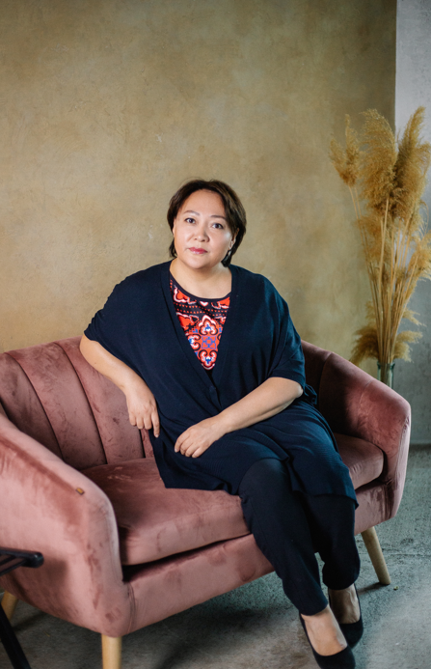
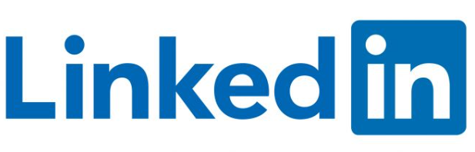
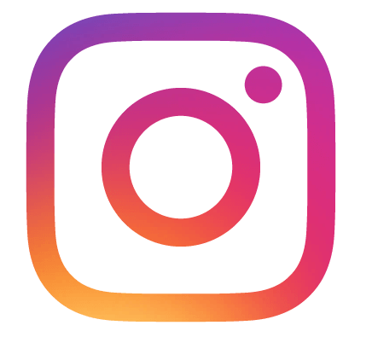
Aizhan Khamitova
Stakeholder Relations Expert (GR, PR, CSR, internal comms and mass media).
GR HUB Administrator. Coach, ACSTH ICF.
M.Kh. Dulaty Taraz State University;
Financial Academy under the Government of the Russian Federation (Moscow)
Executive MBA, Kazakhstani Institute of Management, Economics and Forecasting: the topic of the thesis is “Women's leadership: features of the development of women's careers in Kazakhstan”.
Top 50 Women leaders in the oil and gas industry in 2020 and Top 30 in 2021
Top 10 most influential GR and PR experts in the oil and gas industry of Kazakhstan in 2021
Member of the Women's Energy Club under the Kazenergy Association
Member of the Executive Committee “Society of Petroleum Engineers-Astana Section”
Ambassador of the EBRD program “Mentoring for women entrepreneurs in Kazakhstan 2022”
Aizhan Khamitova
vzhiki_astana

Slide 3

Life values

Slide 4
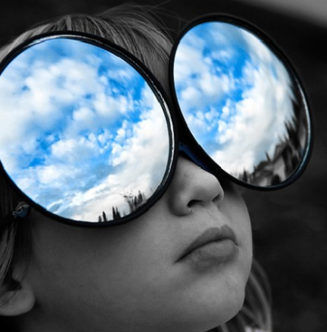
Sources of generational values:
Large-scale events
Information communications in the society
Approaches to education
Shortage

Slide 5
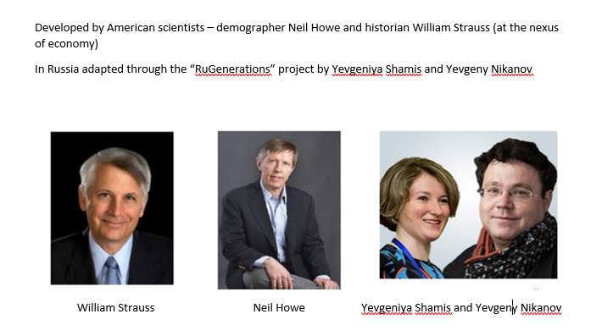

Slide 6
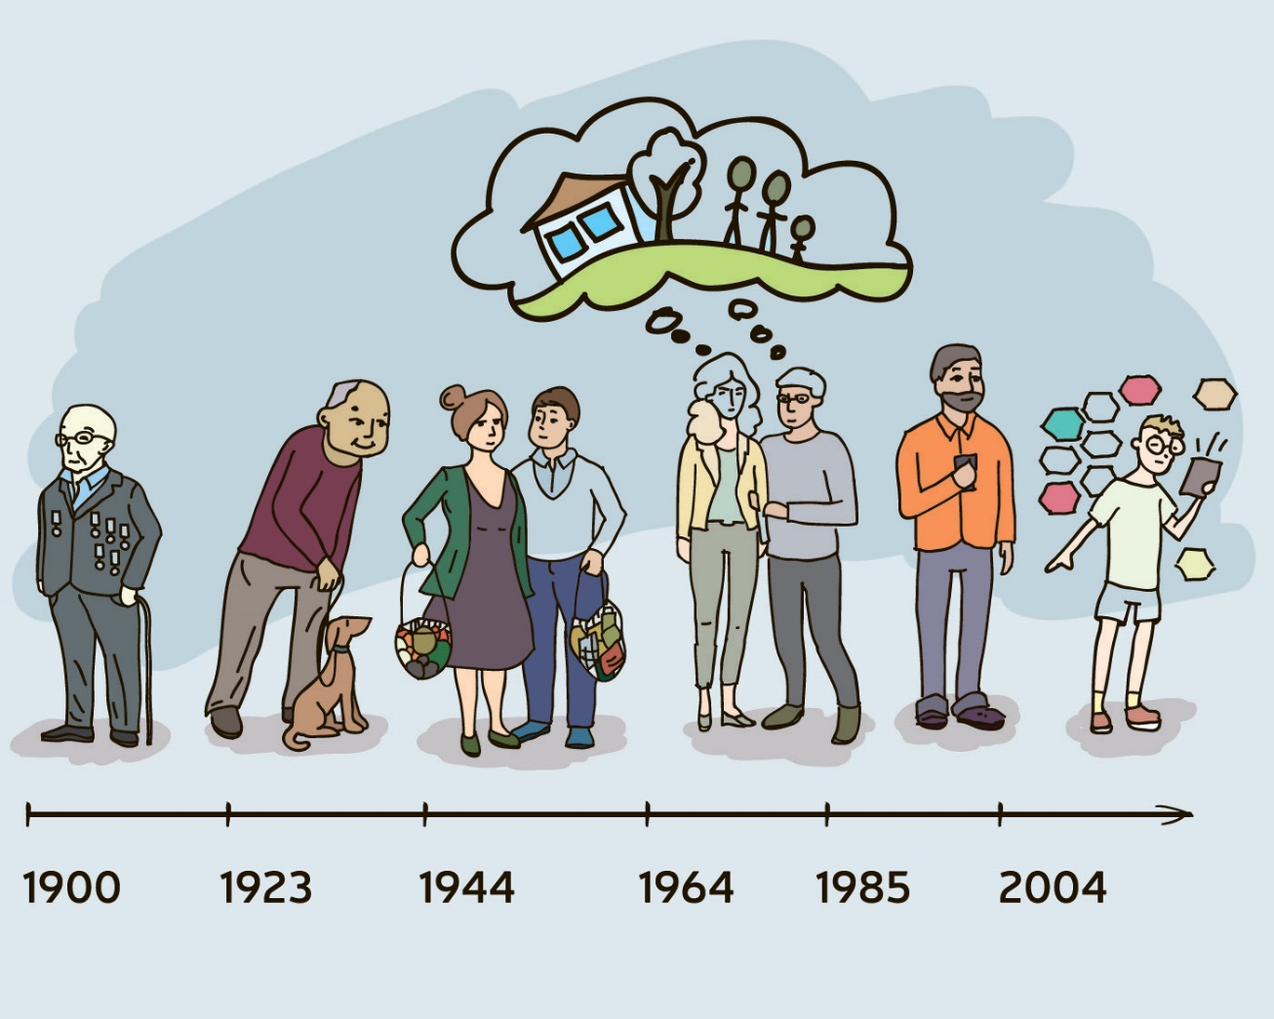
Generations
Heroes
Silent
Baby Boomers
Х
Y
Z

Slide 7
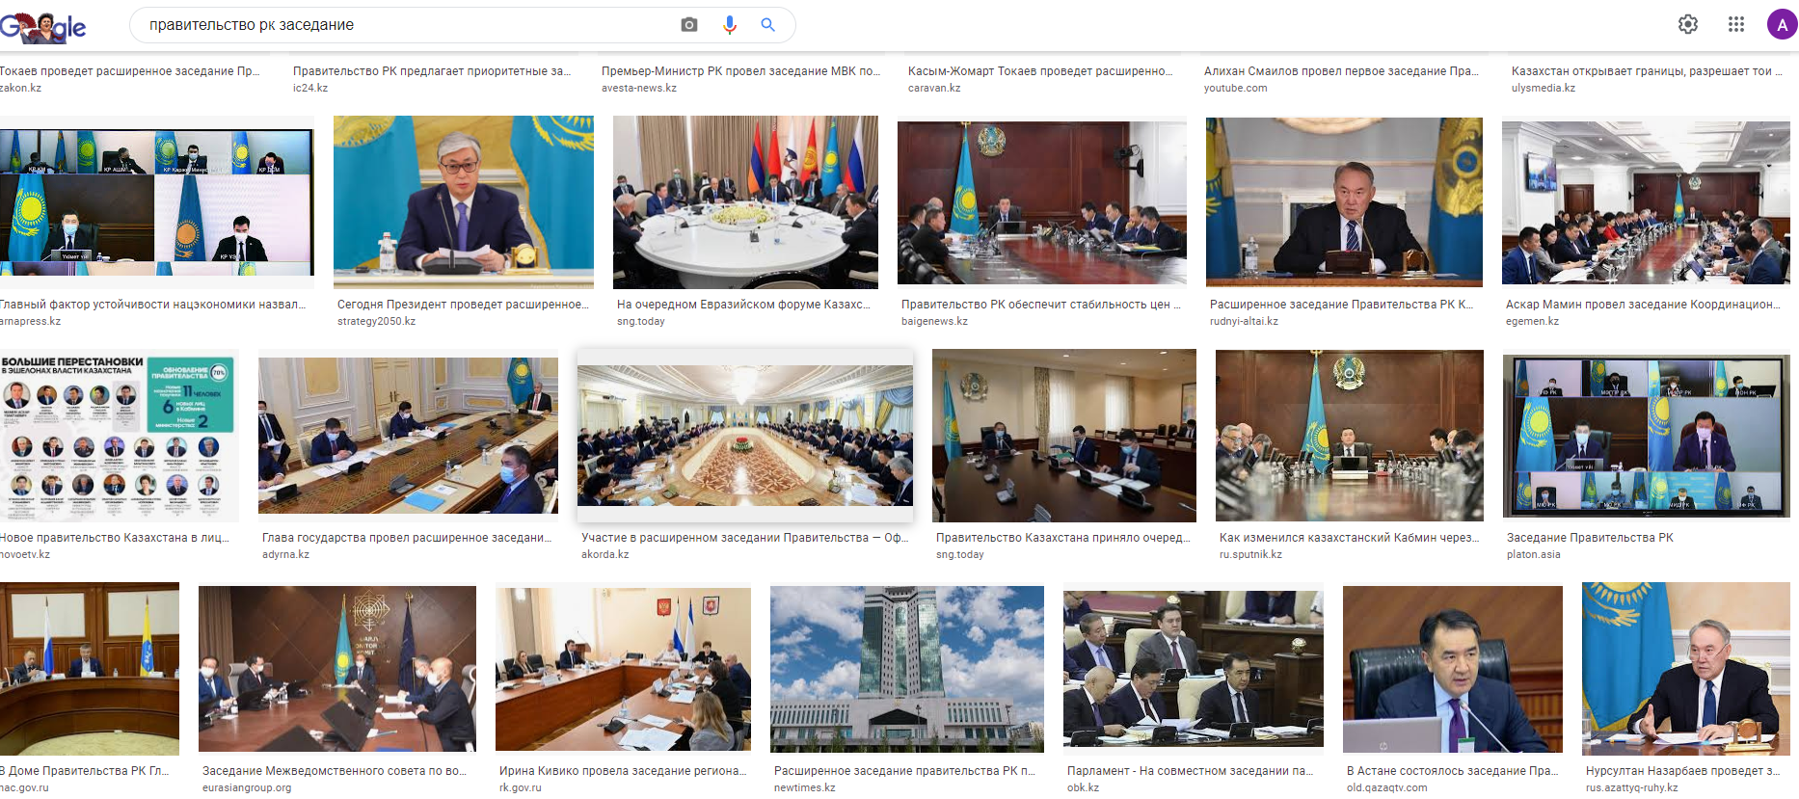
Baby boomers
1944-1963

Slide 8
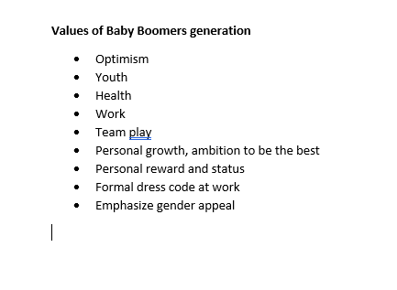
Set bar high
Challenges
Dream big

Slide 9
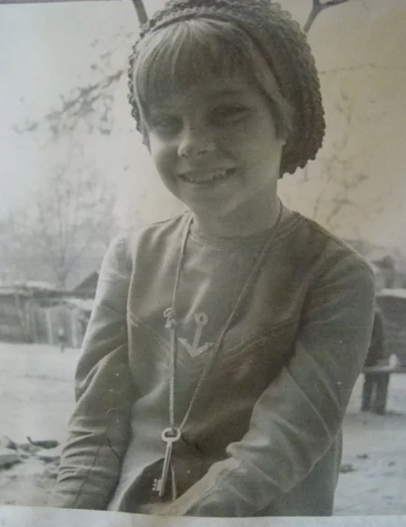
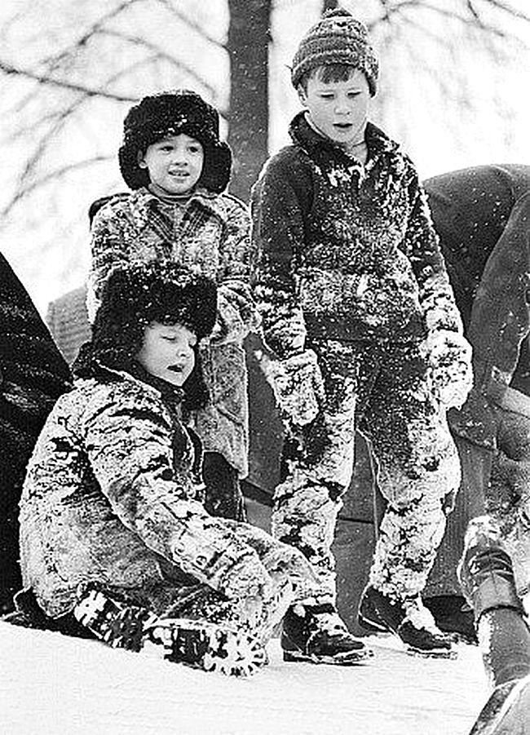
Gen X
Flexible
Independent
Professionals
1964-1985:
The key is around the neck
Perestroika, shortages, personal computers, the war in Afghanistan, the fall of the Berlin Wall

Slide 10
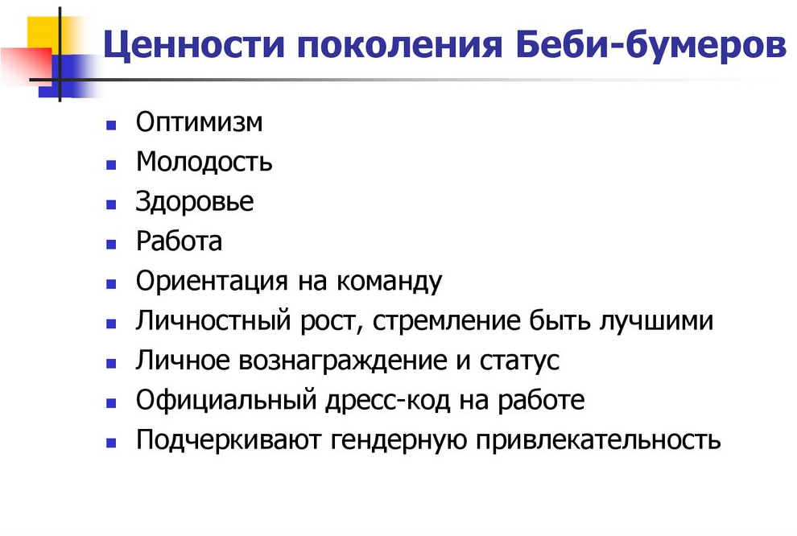

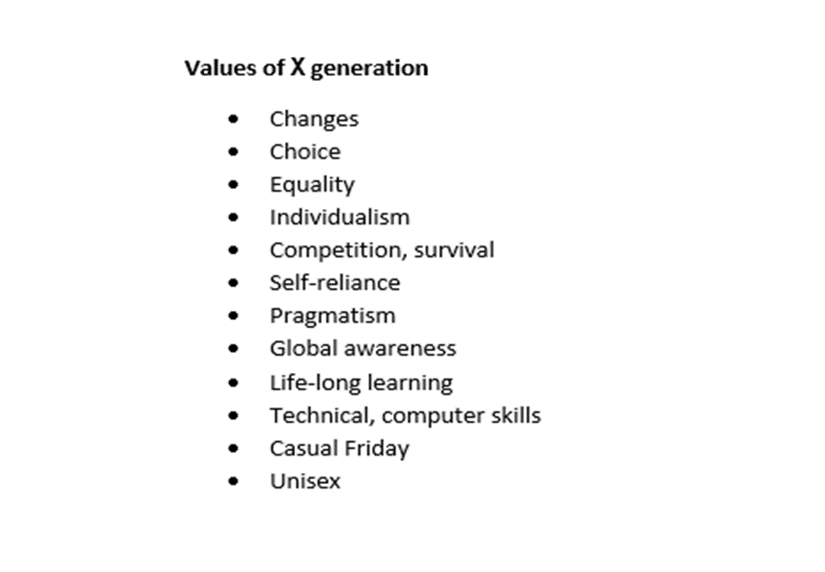

Set bar high
Challenges
Dream big

Slide 11

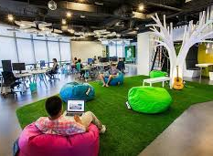
Millenniums (У)
Impact
Environment
Ghost
Goal, result
Time is important
1985-2003

Slide 12

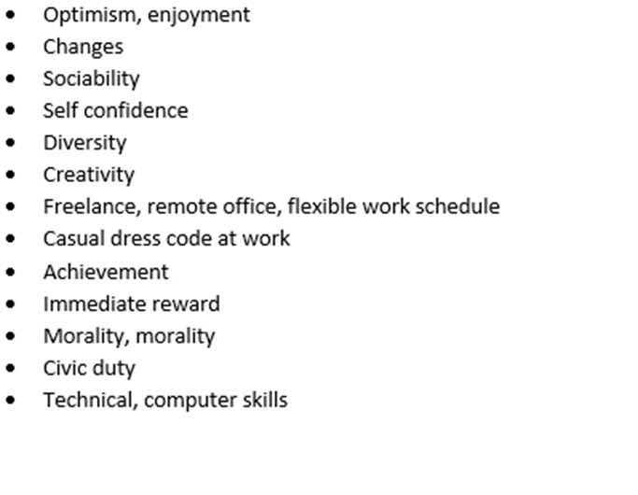
Set bar high
Challenges
Dream big

Slide 13

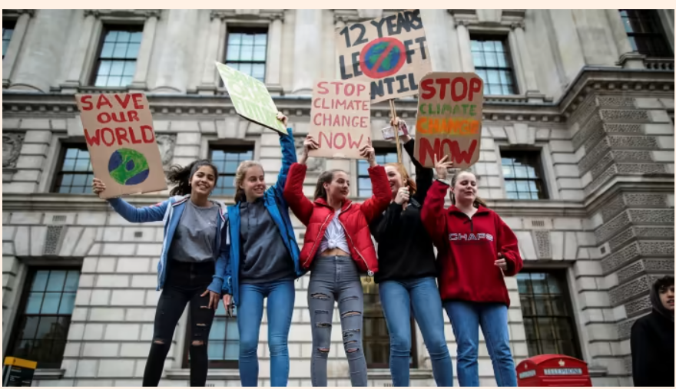
Millennials will revolutionize ESG

Slide 14
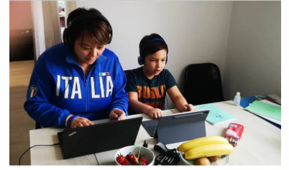
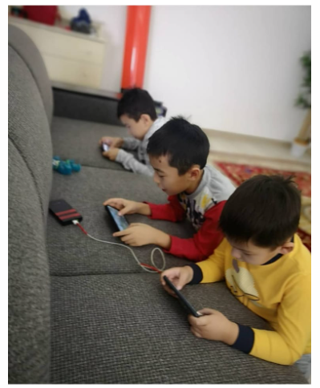
“National Security” generation
Homebodies
Grew up with financial problems of parents
Fight against terrorism
Born with gadgets
Zoomers
2004- 2023

Slide 15
Who is next?
Alpha
Rise, Spring
The task is to see the improvement of life in the country, on the basis of this, create morality, religion in society, make long plans and be an idealist.

Slide 16
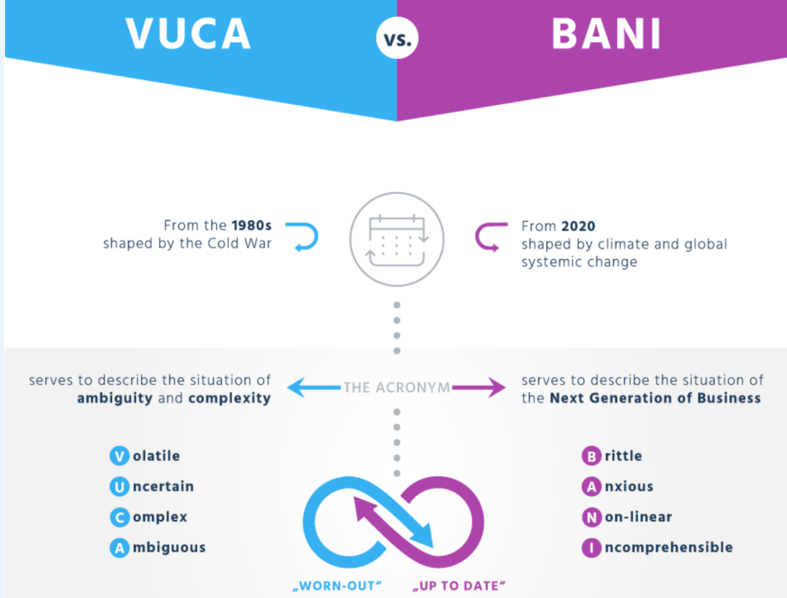

Our world

Slide 17
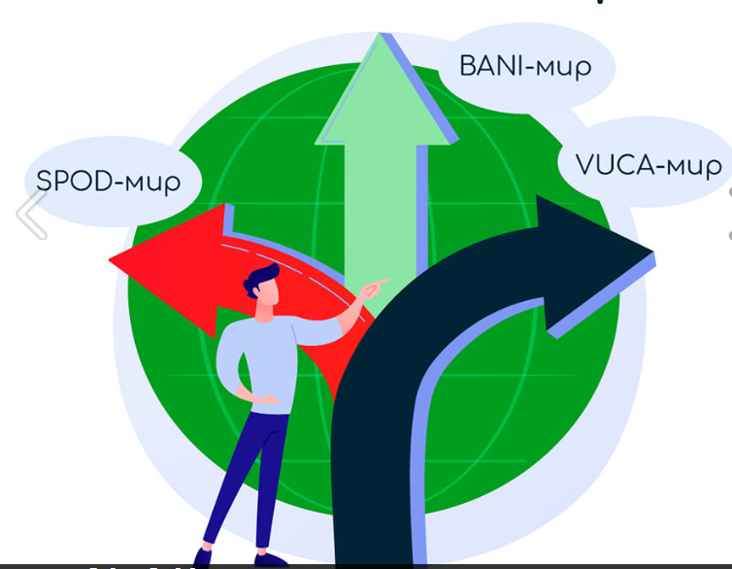
A new world, new realities

Slide 18
Thank you and welcome at ECO TALKS with the youth of WKO
“Green policy for a sustainable future”

